Slide 1
Writing in APA Format: 6th ed. Publication Manual

Slide 2

What does APA regulate?
Stylistics
In-text citations
References (a list of all the sources used in the paper)

Slide 3
Writing Style (pp. 65-70)
APA emphasizes clear communication, organization, and smooth and precise style
Continuity in presentation of ideas
Smoothness of expression
Precision and Clarity

Slide 4
Precision and Clarity
Avoid colloquial (non-formal) expressions:
“I will come up with a research…”
“Many times…”
“Whether or not…”
Avoid approximations that are ambiguous and interpreted differently by different readers:
“quite a large part”
“most people”
Avoid clichés
“Old as time”
“All that glitters is not gold”
Your written presentation should be professional; it should not sound the way you speak.

Slide 5
Word Choice
Word choice influences how the reader interprets your paper
Use “participants” instead of “subjects”
Do not use words such as “prove” or “proof” because we cannot prove a hypothesis or theory with a single study
Use “contribute” or “support” instead
Avoid poetic language
Minimize figurative language (e.g. metaphors)
Do not use rhyming schemes
Use simple, descriptive language

Slide 6
Abbreviations
If you are going to be using a term, name, or expression more than three times or if the abbreviation is popular (FDA), then you should abbreviate it.
The first time use the full expression followed by the abbreviation in parenthesis. From then on you should use the abbreviation.
Obsessive Compulsive Disorder (OCD) is often considered a genetic disorder. Previous investigations found that OCD occurs more in females than in males.

Slide 7
Grammar (pp. 77-86)
Use complete sentences
No fragments
Complex sentences are welcomed
No contractions:
Incorrect: “The results didn’t show an increase…..”
Correct: “The results did not show an increase…..”
Verbs
Use past tense (showed) or present perfect tense (has shown) when describing previous research.

Slide 8
Reducing Bias in Language (pp. 70-77)
Avoid sexist bias: e.g., do not use he to refer to both sexes
Avoid gendered pronouns
Avoid “he” or “she”
Rephrase the sentence to use “they” or “their”
Racial and ethnic identities, disabilities, & age are other areas to avoid language bias.
You can describe participants using the parameters of your research
E.g. “Results showed differences between those with high self-esteem compared to those with low self-esteem….”
E.g. “Patients diagnosed with cancer…”

Slide 9
General Format
Standard-sized paper (8.5 x 11)
Typed- 12 pt Times New Roman font
Double-spaced
1 inch margins on all sides
Running Head on every page
Page number on every page

Slide 10
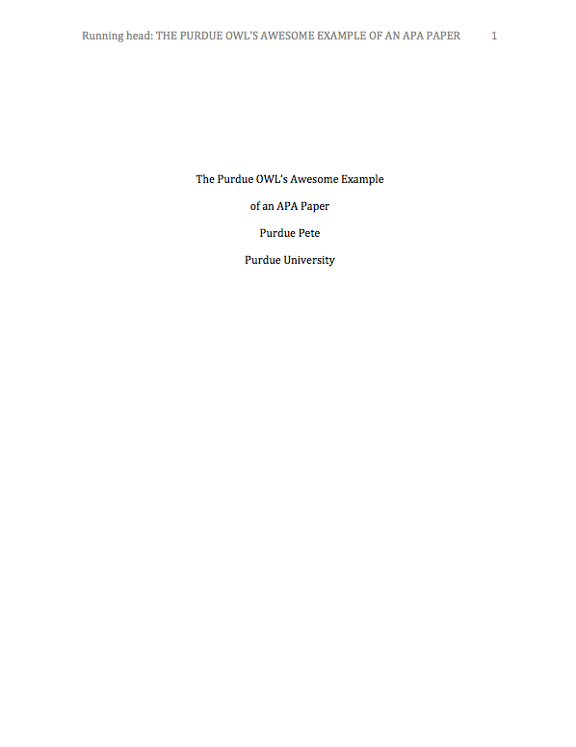
Title Page
Page header:
Title flush left
“Running head: ABBREVIATED TITLE”
No more than 50 characters
Page number flush right-just the number
Use the “Insert Header” option
Repeated on every page

Slide 11
Title Page
Title:
Upper half of the page and centered
Double-spaced
Full title of the paper
No more than 12 words
No abbreviations
Upper & lower case letters
Name (no title or degree)
Affiliation (university, etc.)
No date & Instructor name

Slide 12
References: The Basics
Titles:
Capitalize only the first letter of the first word of a title and subtitle, the first word after a colon or a dash in the title, and proper nouns.
Journals:
Capitalize the first letter of all major words in the title of a journal
In italics
Volume:
In italics

Slide 13
Reference Examples
Electronic journal:
Author, A.A., Author, B.B., & Author, C.C. (year). Title of the article. Title of the Journal, xx, pp-pp. doi #
Morris, S. B., Daisley, R. L., Wheeler, M., & Boyer, P. (2015). A meta-analysis of the relationship between individual assessments and job performance. Journal of Applied Psychology, 100, 5-20. doi:10.1037/a0036938

Slide 14
In-class exercise:
How to write the correct reference for the following article?
Link to the article
Minbashian, A., Bright, J. H., & Bird, K. D. (2009). Complexity in the relationships among the subdimensions of extraversion and job performance in managerial occupations. Journal of Occupational and Organizational Psychology,82, 537-549. doi:10.1348/096317908X371097

Slide 15
In-text Citations: Two Choices
Whenever you refer to ideas or findings that are originally from another researcher, you MUST cite your source.
Include the author’s LAST name and the date of publication
NEVER include the title of the article or journal you used within text
For quotations and close paraphrases, provide a page number as well ← refrain from using quotes too much

Slide 16
In-text Citations: Two Choices
Two types of citations:
In-text: Lonsbary and Jones (2002) found that conversation increases empathy.
Parenthetically: Engaging in conversation increases empathy (Lonsbary & Jones, 2002).
Notice that there is not a period before the citation. The period only goes at the end of the sentence, following the citation.

Slide 17
In-text Citations: A work with 3 to 5 authors
When citing a work with three to five authors, identify all authors in the first phrase or in parenthesis
Harklau, Siegal, and Losey (1999) or (Harklau, Siegal, & Losey, 1999)
In subsequent citations, only use the first author's last name followed by "et al." in the signal phrase or in parentheses
(Harklau et al., 1999) ← notice that there is not a comma between the author’s name and “et al.”
“et al” = and others in latin

Slide 18
In-text Citations: 6 and more authors
When citing a work with six and more authors, identify the first author’s name followed by “et al.”
Smith et al. (2006) maintained that….
….. (Smith et al., 2006)
When referring to a work with more than six authors in-text:
Smith and colleagues (2006) investigated….

Slide 19
In-class exercise:
How to cite the following articles in your paper?
Edwards, J. R., & Lambert, L. S. (2007). Methods for integrating moderation and mediation: A general analytical framework using moderated path analysis. Psychological Methods, 12, 1-22. doi:10.1037/1082-989X.12.1.1
Cuddy, A., Glick, P. & Beninger, A. (2011). The dynamics of warmth and competence judgments, and their outcomes in organizations. Research in Organizational Behavior, 31, 73–98. doi:10.1016/j.riob.2011.10.004

Slide 20
If you need help with APA
Websites:
http://owl.english.purdue.edu
http://www.apastyle.org
UAH Writing Center
Publication Manual of the American Psychological Association, 6th ed.
Come to the workshops for your paper assignment!

